Slide 1
Merge Sort
Comparison Sort Technique

Slide 2
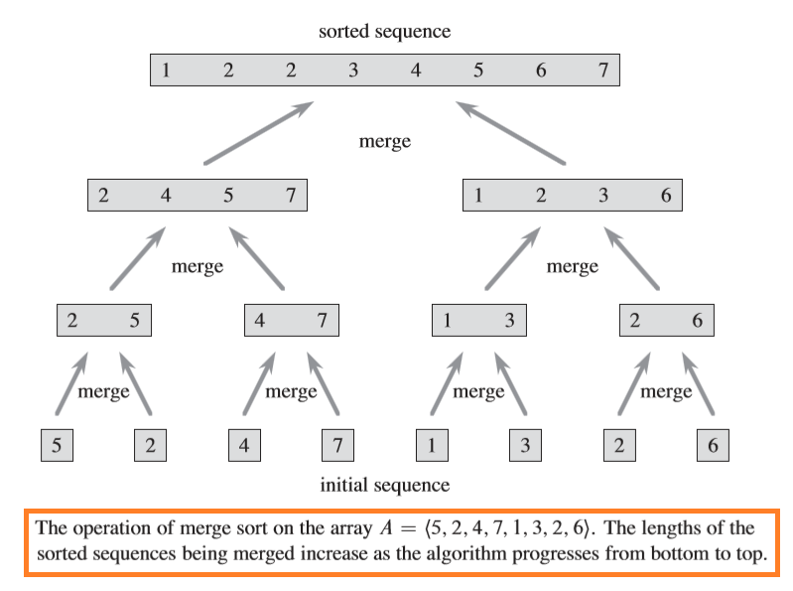

Slide 3
